Slide 1
IP Addresses and Subnet Masks
Where do we draw the line?

Slide 2
Exercise Review
 |  | Octet 1 in 8 bit binary | Octet 2 in 8 bit binary | Octet 3 in 8 bit binary | Octet 4 in 8 bit binary
IP Host Address | 192.168.12.84
Subnet Mask | 255.255.255.0
Result After AND
IP Address
IP Host Address | 10.10.100.150
Subnet Mask | 255.255.192.0
Result After AND
IP Address
IP Host Address | 192.168.5.12
Subnet Mask | 255.255.255.128
Result After AND
IP Address
IP Host Address | 192.168.0.1
Subnet Mask | 255.255.255.240
Result After AND
IP Address
IP Host Address | 10.200.100.90
Subnet Mask | 255.224.0.0
Result After AND
IP Address
IP Host Address | 10.80.90.100
Subnet Mask | 255.0.0.0
Result After AND
IP Address
IP Host Address | 192.168.254.254
Subnet Mask | 255.255.255.0
Result After AND
IP Address
IP Host Address | 10.200.220.240
Subnet Mask | 255.255.254.0
Result After AND
IP Address
 |  | Octet 1 in 8 bit binary | Octet 2 in 8 bit binary | Octet 3 in 8 bit binary | Octet 4 in 8 bit binary
IP Host Address | 192.168.12.84 | 11000000 | 10101000 | 00001100 | 01010100
Subnet Mask | 255.255.255.0 | 11111111 | 11111111 | 11111111 | 00000000
Result After AND |  | 11000000 | 10101000 | 00001100 | 00000000
IP Address |  | 192 | 168 | 12 | 0
IP Host Address | 10.10.100.150 | 00001010 | 00001010 | 01100100 | 10010110
Subnet Mask | 255.255.192.0 | 11111111 | 11111111 | 11000000 | 00000000
Result After AND |  | 00001010 | 00001010 | 01000000 | 00000000
IP Address |  | 10 | 10 | 64 | 0
IP Host Address | 192.168.5.12 | 11000000 | 10101000 | 00000101 | 00001100
Subnet Mask | 255.255.255.128 | 11111111 | 11111111 | 11111111 | 10000000
Result After AND |  | 11000000 | 10101000 | 00000101 | 00000000
IP Address |  | 192 | 168 | 5 | 0
IP Host Address | 192.168.0.1 | 11000000 | 10101000 | 00000000 | 00000001
Subnet Mask | 255.255.255.240 | 11111111 | 11111111 | 11111111 | 11110000
Result After AND |  | 11000000 | 10101000 | 00000000 | 00000000
IP Address |  | 192 | 168 | 0 | 0
IP Host Address | 10.200.100.90 | 00001010 | 11001000 | 01100100 | 01011010
Subnet Mask | 255.224.0.0 | 11111111 | 11100000 | 00000000 | 00000000
Result After AND |  | 00001010 | 11000000 | 00000000 | 00000000
IP Address |  | 10 | 192 | 0 | 0
IP Host Address | 10.80.90.100 | 00001010 | 01010000 | 01011010 | 01100100
Subnet Mask | 255.0.0.0 | 11111111 | 00000000 | 00000000 | 00000000
Result After AND |  | 00001010 | 00000000 | 00000000 | 00000000
IP Address |  | 10 | 0 | 0 | 0
IP Host Address | 192.168.254.254 | 11000000 | 10101000 | 11111110 | 11111110
Subnet Mask | 255.255.255.0 | 11111111 | 11111111 | 11111111 | 00000000
Result After AND |  | 11000000 | 10101000 | 11111110 | 00000000
IP Address |  | 192 | 168 | 254 | 0
IP Host Address | 10.200.220.240 | 00001010 | 11001000 | 11011100 | 11110000
Subnet Mask | 255.255.254.0 | 11111111 | 11111111 | 11111110 | 00000000
Result After AND |  | 00001010 | 11001000 | 11011100 | 00000000
IP Address |  | 10 | 200 | 220 | 0

Slide 3
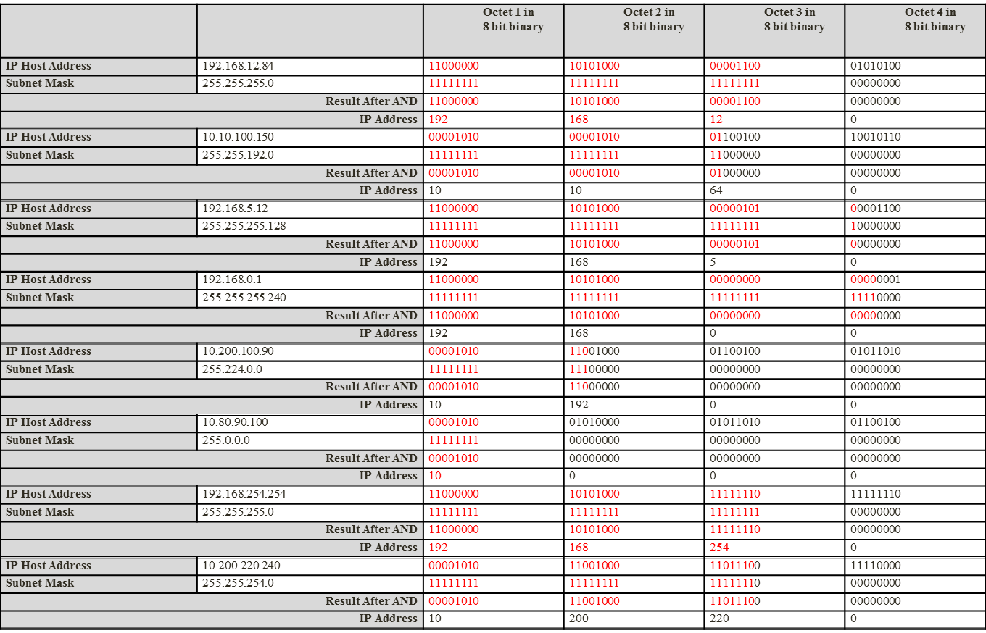
What Can We Conclude?
When we apply a bitwise AND to an IP Host Address and it’s Subnet Mask, we in effect keep all the binary bits in the network portion, but turn all the bits in the host portion to 0’s. This defines the network address space that we belong to, in other words the network address. We can break this down further by saying:-
We are not allowed to touch/change any bits that are in the network portion of an IP Address
In order to find the Network that a host belongs to, we simply change all the host bits to 0’s

